Slide 1



||Shri Hari||
BCSC0011: THEORY OF
AUTOMATA & FORMAL
LANGUAGES
(Module-II)
By: Dr. Sandeep Rathor

Slide 2

Module II
 Context Free Grammar and Context Free Languages: Introduction,
Derivation Trees or Parse Tree
 Ambiguity in Grammar, Ambiguous to Unambiguous CFG
 Simplification of CFGs: Removal of useless symbols, elimination of null productions, elimination of unit productions
 Normal Forms for CFGs - CNF and GNF
 Pumping lemma for CFLs

Equivalence of PDA and CFG
 Turing Machine

Slide 3
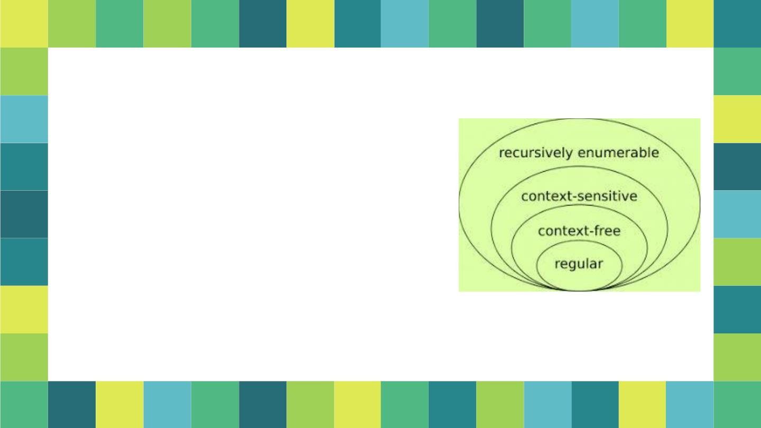
Context-Free Grammars
 Languages that are generated by
context-free grammars are context-
free languages
 Context-free grammars are more
expressive than finite automata: if a
language L is accepted by a finite
automata then L can be generated
by a context-free grammar
 Beware:
The converse is NOT true
3

Slide 4
A Grammar is the collection of 4-tuple i.e. G = (V_{N} , Σ, P, S) where: V_{N:} Set of Variables; Σ: Set of Terminals P: Production Rule; S: Start Symbol V_{N} ={<Sentence>,<noun>,<verb>,<adverb>} Σ={sandeep, hari, read, quickly} S=<Sentence> <Sentence> <noun><verb><adverb> <noun> Sandeep, hari <verb> read <adverb> quickly

Slide 5
Validation Rules: 1. If S->BC is a given production, it means we can replace S by BC but can not replace BC by S. [Reverse substitution is not possible] 2. If S->BC is a given production, it is not necessary that BC->S is a production. [No inverse operation is permitted]

Slide 6
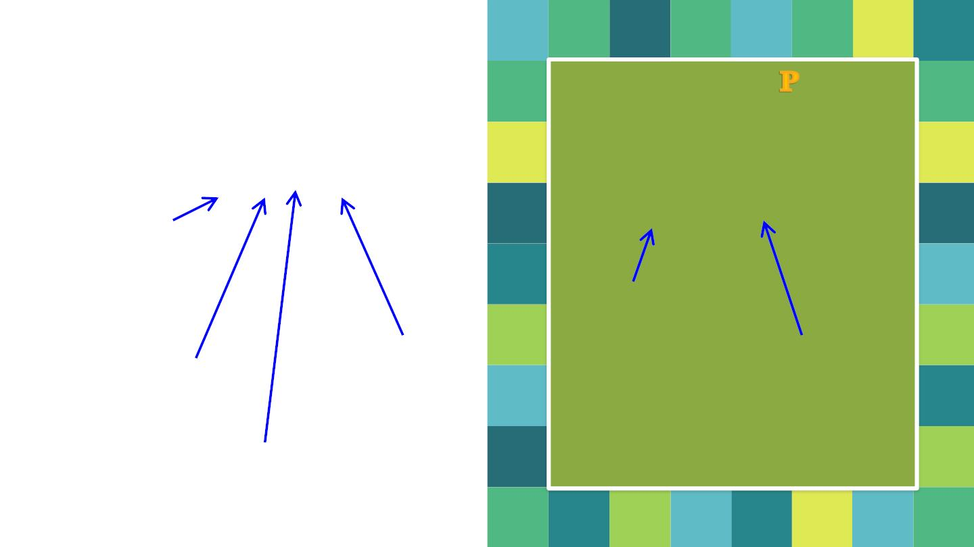
Formal Definition
Grammar
All productions in are of
the form
G = (V_{N} , Σ, P, S)
A 
Finite Set of
Variables /
Non
Terminals
Variable
Start
variable
String of
variables and
terminals
Finite Set of
terminal
symbols
Set of
Productions rules

Slide 7
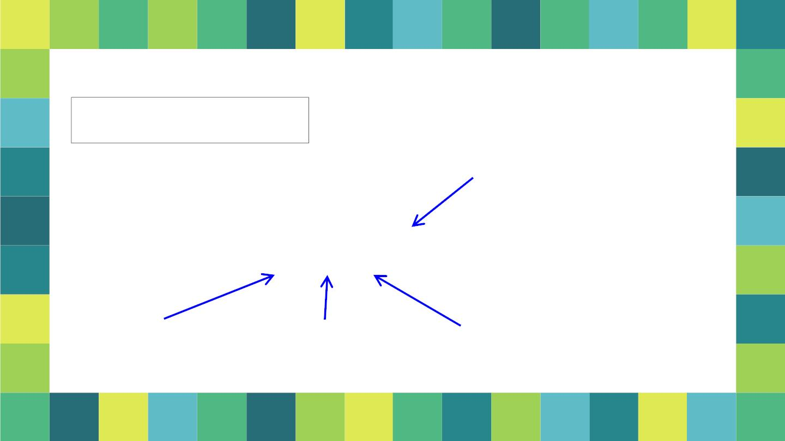
Example of Context-Free Grammar
S  aSb | ●
P  {S  aSb, S  }
productions


G  V_{N}, ,S, P
V_{N}  {S}
  {a,b}
start variable
variables
terminals
5

Slide 8
Chomsky Classification on Grammar
According to Noam Chomosky, there are four types of grammars −
Type 0, Type 1, Type 2, and Type 3.
Grammar Type | Grammar Accepted | Language Accepted | Automaton
Type 0 | Unrestricted grammar | Recursively enumerable language | Turing Machine
Type 1 | Context-sensitive grammar | Context-sensitive language | Linear-bounded automaton
Type 2 | Context-free grammar | Context-free language | Pushdown automaton
Type 3 | Regular grammar | Regular language | Finite state automaton

Slide 9
Type-0 grammars
The productions have no restrictions.
Type-1 grammars generate context-sensitive languages. The productions must be in the form α A β → α γ β
where A ∈ N (Non-terminal)
and α, β, γ ∈ (V_{N}U )* (Strings of terminals and non-terminals)
The strings α and β may be empty, but γ must be non-empty.
Type 0 known as unrestricted grammar.
Type 1 known as context sensitive grammar.
Type 2 known as context free grammar.
Type 3 Regular Grammar.
AB → AbBc
A → bcA
B → b

Slide 10
Type-2 grammars generate context-free languages. The productions must be in the form A → α, where A ∈ V_{N} (Non terminal) and α ∈ (V_{N} U )* It should be type1 Type-3 grammars generate regular languages. Type-3 grammars must have a single non-terminal on the left-hand side and a right-hand side consisting of a single terminal or single terminal followed by a single non-terminal. The productions must be in the form X → a or X → aY where X, Y ∈ V_{N} (Non terminal) and a ∈  (Terminal)
S → Xa
X → a
X → aX
X → abc
X → ε
X → ε
X → a | aY
Y → b

Slide 11
Derivation Trees or Parse Tree
▪ Given a derivable string, we may represent the derivation
by a derivation / parse tree.
▪ A parse tree is a tree with the following properties:
Every vertex has a label which is a variable or terminal or null (λ).
The root node is the start symbol S.
The label of an internal vertex is a variable.
If the vertices n1,n2,…nk written with labels X1, X2,….,Xk are the sons of vertex n with label A, then A->X1,X2,…Xk is a production in P.
A vertex n is a leaf if its label is a ∈ Σ or null.

Slide 12
Example: Let G=({S,A}, {a,b}, P, S), where P consists of S->aAS|a|SS, A->SbA|ba
▪ Two derivations are equivalent if they have the same parse tree
Note: The yield of a derivation tree is the concatenation of the labels of the leaves without repetition in the left to right ordering

Slide 13
Example: Let G=({S,A}, {a,b}, P, S), where P consists of S->aAS|a|SS, A->SbA|ba. Find derivation tree for string aabaa
▪ Two derivations are equivalent if they have the same parse tree

Slide 14

Example of a
Derivation Tree
▪ Let the grammar G be
□ S → AB
□ A → aAb | λ
□ B → bB | λ
▪ Let the string be w =
aabbbb.
▪ Derive the string w.
9

Slide 15
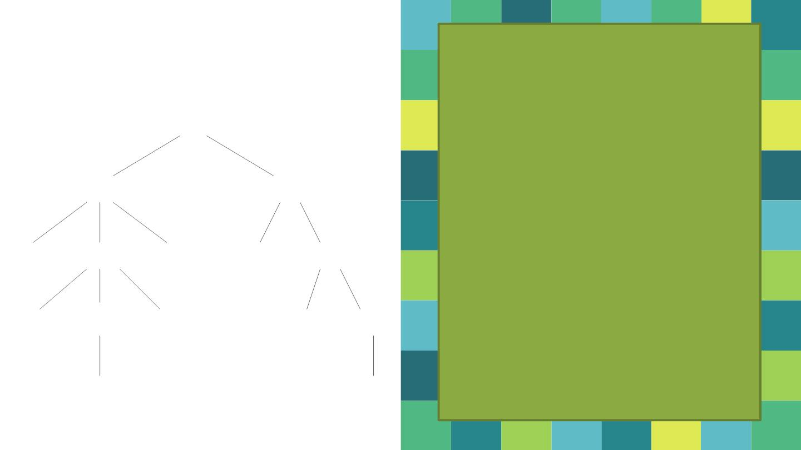
Now draw the Parse
Tree of aabbbb
This is the parse tree of many
different, but equivalent,
derivations of aabbbb.
S
For example,
A
A
B
S  AB  aAbB  aaAbbB 
aabbB  aabbbB 
aabbbbB  aabbbb.
a
b
b
B
a A
b
b B
S  AB  AbB  AbbB 
Abb  aAbbb  aaAbbbb 
aabbbb.
λ
λ
10

Slide 16
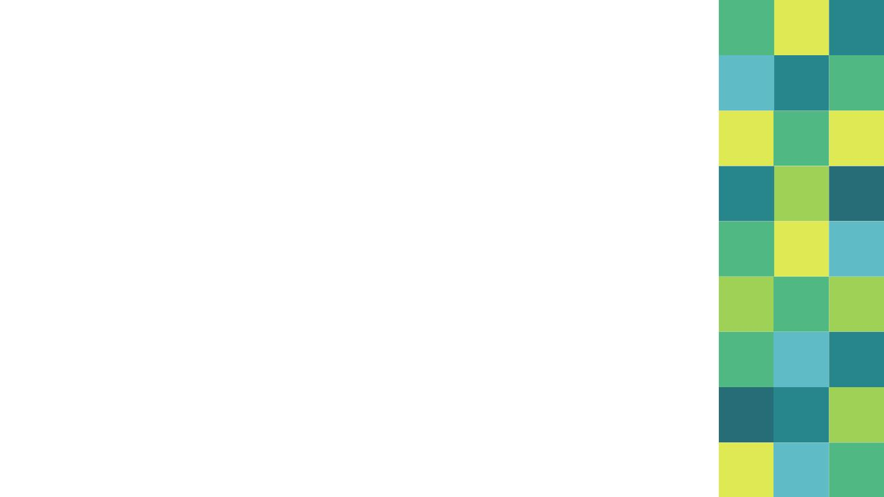
Leftmost and Rightmost Derivations
1. Leftmost Derivations
▪ A leftmost derivation of a string is a derivation in
which each production rule is applied to the
leftmost non terminal in the string.
or
A derivation A=>w is called a left most derivation
(LMD) if we apply a production only to the leftmost variable at every step.
*
11

Slide 17
2. Rightmost Derivations
▪ A rightmost derivation of a string is a derivation
in which each production rule is applied to the
rightmost non terminal in the string.
or
A derivation A=>w is called a rightmost derivation (RMD) if we apply a production only to the rightmost variable at every step.
*
11

Slide 18
Example: Let G be the grammar S->0B|1A, A->0|0S|1AA, B->1|1S|0BB. For the string 00110101, find: a) LMD b) RMD c) Derivation Tree or Parse Tree
Solution: LMD: S=>0B=>00BB=>001B=>0011S=>00110B=>001101S=>0011010B=>00110101
RMD: S=>0B=>00BB=>00B1S=>00B10B=>00B101S=>00B1010B=>00B10101=>00110101
Parse Tree:

Slide 19
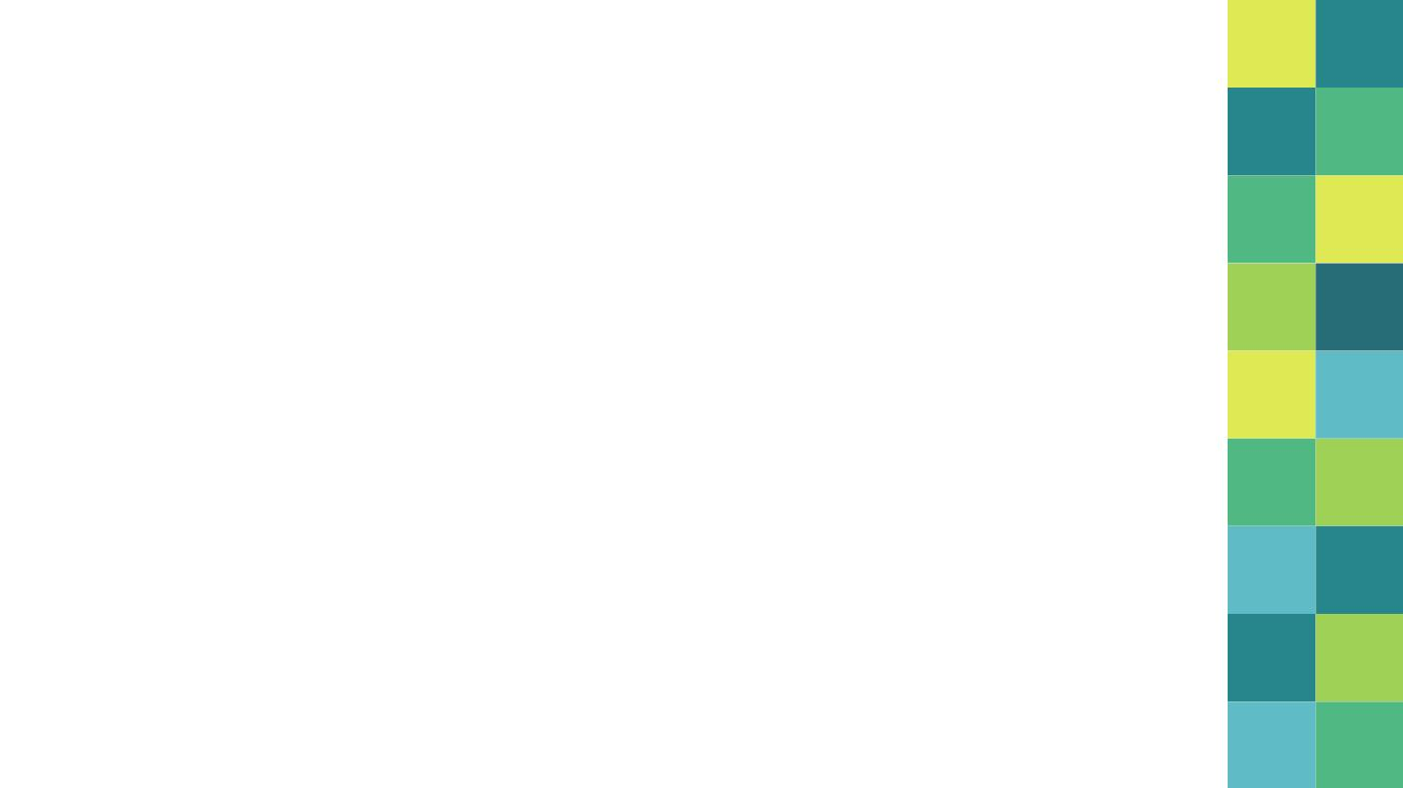
Ambiguous Grammars
 If there exists w  L(G) such that w has two or
more different
. parse trees or
. leftmost (or rightmost) derivations ,
 then G is ambiguous.
12

Slide 20
Consider the grammar G with production rules −
S → S+S | S*S |a| b
Find two Left Most Derivations of the string "a+a*b”
Derivation 1 : S → S+S → a +S → a+ S*S → a+a*S → a+a*b
Derivation 2 : S → S*S → S+S*S → a+ S*S → a+a*S → a+a*b

Slide 21
Parse trees for a+a*b

Slide 22

If G is the grammar S → SbS |a, show that G is
ambiguous.
Consider w=abababa
13

Slide 23
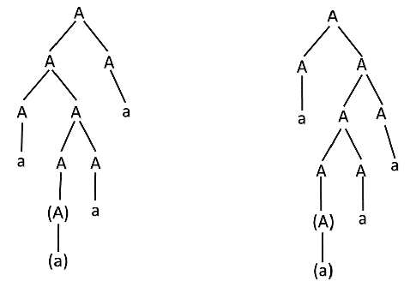
Example1
E → E + E
E → E - E
E → id
Example1
A → AA
A → (A)
A → a
Prove that grammar is ambiguous…
For the string "a(a)aa"
String "id + id - id“
First Leftmost derivation
E → E + E
→ id + E
→ id + E - E
→ id + id - E
→ id + id- id
Two different parse tree for the same string:
Second Leftmost derivation
E → E - E
→ E + E - E
→ id + E - E
→ id + id - E
→ id + id - id

Slide 24

▪ Ambiguity can be removed
by rewriting the grammar
such that there is only one
derivation or parse tree
possible for a string of the
language which the
There are some inherently
ambiguous languages like
L = {a^{n}b^{n}c^{m}} ∪ {a^{n}b^{m}c^{m}}
grammar represents.
E.g.
 Ambiguous Grammar
S → SbS | a
 Can be rewritten as
S → abS | a
15

Slide 25
Rule: A-> Aα₁ |Aα₂ |Aα₃ |…| Aα_{m} |B₁ | B₂ |…| B_{n} where no B_{i ,} begin with A. then we replace the A-production by:
A-> B₁ A’| B₂A’ |…| B_{n} A’
A’-> α₁A’ |α₂A’ |…| α_{m}A’| λ
[Note: productions of the form of A->Aα, called immediate left recursion]
Example: E->E+T | T, T->T*F | F, F->(E) |a
Solution:
E->TE’ E’->+TE’ | λ
T->FT’ T’->*FT’ | λ
F->(E) |a

Slide 26

Simplification
of CFGs
16

Slide 27

Can’t always eliminate ambiguity.
But, CFG simplification & restriction still useful
theoretically & pragmatically.
□ Simpler grammars are easier to understand.
□ Simpler grammars can lead to faster parsing.
□ Restricted forms useful for some parsing
algorithms.
□ Restricted forms can give you more knowledge
about derivations.
17

Slide 28
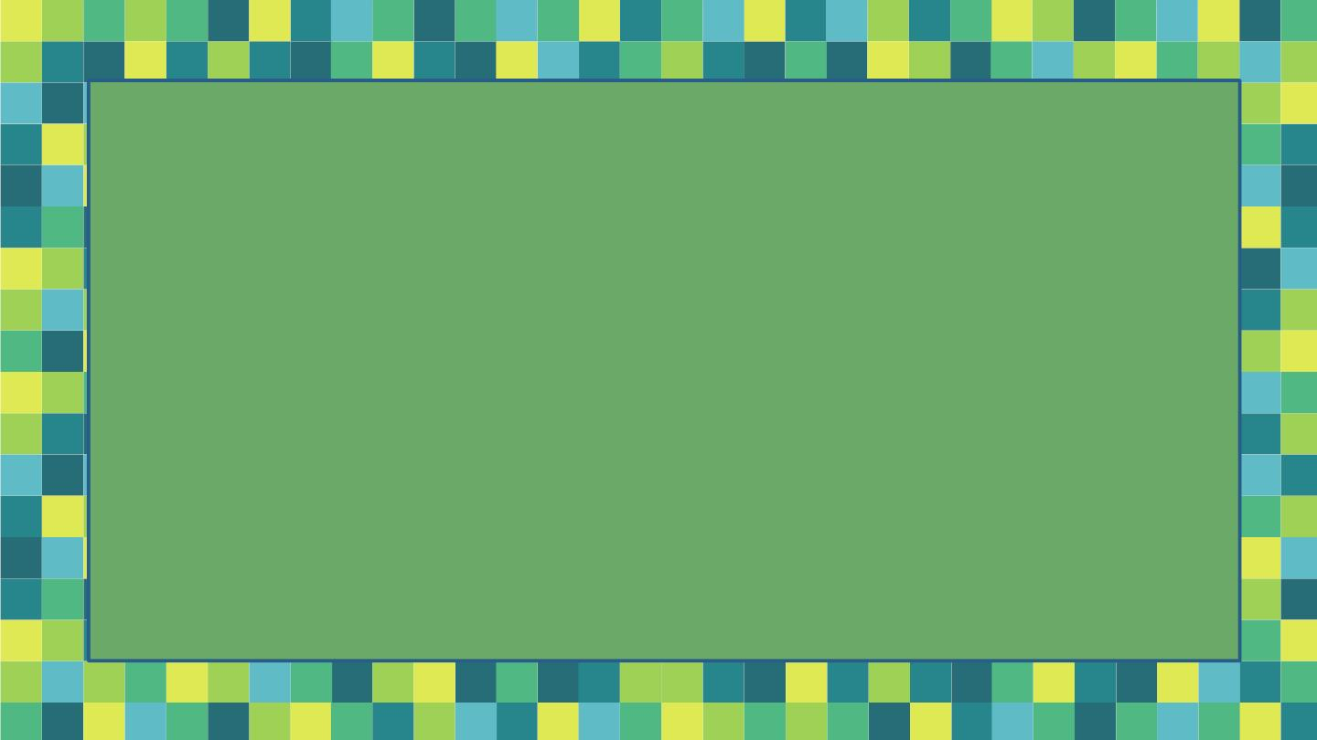
■ Context Free Grammar can be simplified
by:
■ Useless production elimination
or
Construction of Reduced Grammar
■  production elimination
■ Unit production elimination
18

Slide 29
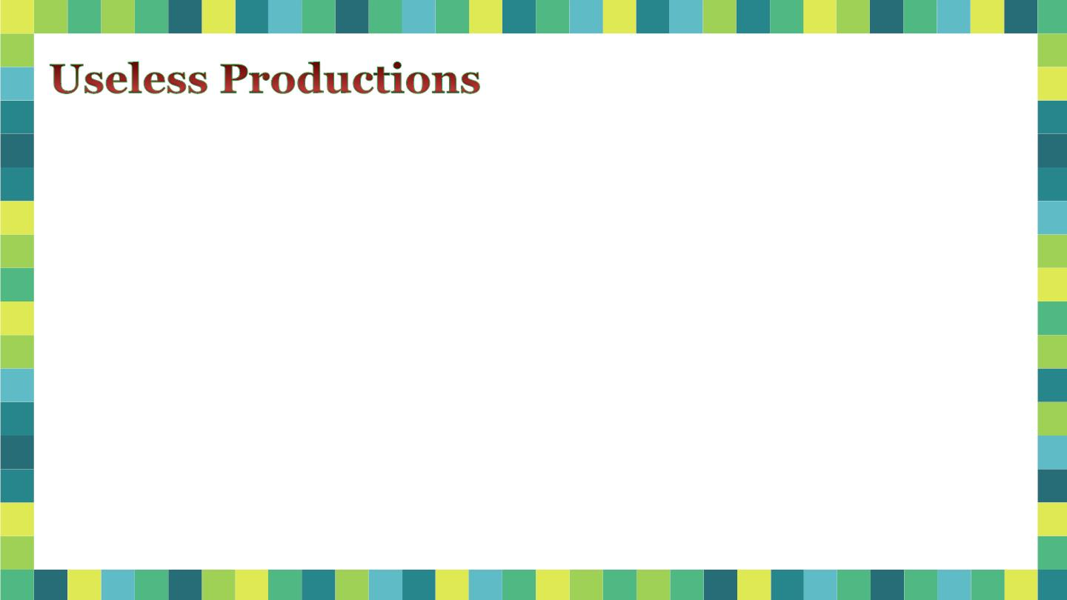
▪ A non-terminal X is useless
Derive some strings
S → aSb | c | Ac
A → aA
if:
□ X does not generate any
string of terminals.
▫ It cannot derive a terminal
B → bB | b
string
OR
Any production involving
a useless symbol is a
□ X does not occur in any
sentential form
useless production.
▫ It cannot be reached from
start symbol

Slide 30
Elimination of Useless
Productions
Phase 1 − Derivation
of an equivalent
grammar, G′, from the
CFG, G, such that each
variable derives
some terminal
string.
20

Slide 31
Construction of V′:
⬧ We define V ′ ⊆ V by recursion
i
⬧ V ′={A ∈ V | there exists a production A →ω
1
where ω ∈ Σ*}
⬧ Vi+1′=V ′ ∪ {A ∈ V| there exists some production A →α
i
with α ∈ (Σ ∪ V ′)*}
i
⬧ At some point V ′=V ′. Then we get V′=V ′
k
k+1
k
⬧ Construction of P′
⬧ P ′ ={A →α |A, α ∈(V′ ∪ Σ)*}

Slide 32
Let G be S →AB, A →a, B →b, B →C, and E → c
Find G’ such that every variable in G’ derives some terminal string.
V ′ = {A, B, E}
A →a, B →b, E → c
S →AB
1
V ′ = {A, B, E, S}
2
V ′ = {A, B, E, S}
3
= V ′
2
Here we get V′={S,A,B,E}.
So P′= S →AB, A →a, B →b and E → c
22

Slide 33
Phase 2 − Derivation of an equivalent grammar, G″, from the CFG, G′,
such that each symbol appears in a sentential form.
Construction of V″:
⬧ We define V ″ ⊆ V by recursion
i
⬧ V ″={S}
1
⬧ Vi+1″=V ″ ∪ {X ∈ V′| there exists some production A →α
i
with A ∈ V ″ & α contains the symbol X}
i
⬧ At some point V ″=V ″. Then we get V″=V ″
k
k+1
k
⬧ Construction of P″
⬧ P″ ={A →α |A, α ∈(V″ ∪ Σ)*}

Slide 34
We had G as S →AB, A →a, B →b, B →C, and E → c
Then we got G′ as S →AB, A →a, B →b and E → c
V ″ = {S}
1
V ″ = {S, A, B}
S →AB
2
V ″ = {S, A, B}
A →a, B →b
3
= V ″
2
Here we get V″={S,A,B}.
So P″= S →AB, A →a, B →b
24

Slide 35
Question: Find a reduced grammar equivalent to the grammar G, having production rules, P: S → AC | B, A → a, C → c | BC, E → aA |e.
Solution:
Step1: Terminals = { a, c, e }
W₁ = { A, C, E } from rules A → a, C → c and E → e
W₂ = { A, C, E } U { S } from rule S → AC
W₃ = { A, C, E, S } U ∅
Since W₂ = W₃, we can derive G’ as −
G’ = { { A, C, E, S }, { a, c, e }, P, {S}}, where P: S → AC, A → a, C → c , E → aA | e
Step2:
V₁ = { S }
V₂ = { S, A, C } from rule S → AC
V₃ = { S, A, C, a, c } from rules A → a and C → c
V₄ = { S, A, C, a, c }
Since V₃ = V₄, we can derive G” as −
G” = { { A, C, S }, { a, c }, P, {S}}, where P: S → AC, A → a, C → c

Slide 36
Construct a reduced grammar equivalent to the grammar:
S-> aAa, A -> Sb |bCC | DaA, C -> abb | DD,
E -> aC, D -> aDA
Solution: Step1:
W1 ={C} as C-> abb is the only production with a terminal string on the R.H.S.
W2 = {C} U {E, A}, as E -> aC and A -> bCC are productions with R.H.S. in (Σ U {C})*
W3 = {C, E, A} U {S}, as S -> aAa and aAa is in (Σ U W2) *
w4 = W3 U ∅
Hence, Vn= W, = {S, A, C, E}
P’= {S-> aAa, A->Sb | bCC, C-> abb, E-> aC}
G’= (Vn, {a, b}, P', S)

Slide 37
Solution: Step2:
W1 = {S}, As we have S-> aAa,
W2 = {S} U {A, a}, As A -> Sb | bCC,
W3 = {S, A, a} U {S, b, C} = {S, A, C, a, b}
As we have C ->abb,
W4 = W3 U {a, b}= W3
Hence P”={{S-> aAa, A->Sb | bCC, C-> abb }
G”= ({S, A, C}, {a, b}, P”, S) is the reduced grammar.

Slide 38
Question: Find a reduced grammar equivalent to the grammar G whose productions are
S->AB|CA, B->BC|AB, A->a, C->aB|b
Solution:
Step1:
G’=({S,A,C}, {a,b}, {S->CA, A->a, C->b}, S)
Step2:
G”=({S,A,C}, {a,b}, {S->CA, A->a, C->b}, S)

Slide 39
Elimination of Null Productions
◉ A CFG may have productions of the form A → λ. So, a production in the form of A → λ, where A is variable, is c/d null production.
If G is a context free grammar, then we can find a context free grammar G1 having no null productions such that L(G)=L(G)-{λ}
◉
25

Slide 40

S → aS | AB
A → λ | a
B → λ | b
D → b
Step 1: Construction of
the set W of all nullable
variables
 W ={A ∈ V | A → λ is a
1
1
1
production in P
 W = W ∪{K ∈ V |  a
i+1
i
production K → α with α ∈
W ={A, B}
1
W * }
i
W ={A, B, S}
2
 At some point W = W
i+1
i
W ={A, B, S}
3
= W₂
26

Slide 41

Step 2: Construction P′
 All prod^{n}s whose RHS
doesn’t have any nullable
variables are included in
P′
A → a
B → b
D → b
 If A → X X … X is in P
1
2
k
then include
A   ☹
S → aS | a | AB | A | B
whe re
if X  W
1 2
k



X
 
i
i
i
●

or X if X W
i
i
Provi de d A   ☹  
1 2
k
27

Slide 42
Question: Remove null production from the following −
S → ASA | aB | b, A → B, B → b | ∈
Solution:
S→ASA | aB | b | a | SA | AS | S, A → B, B → b

Slide 43
Eliminate Null productions:
1. S -> ABAC A -> aA / ϵ B -> bB / ϵ C -> c
Eliminate Null productions:
2. S -> aSb/aAb/ab/a
A -> ε
Solution after null elimination:
S -> aSb/aAb/ab/a
Solution after null elimination:
S -> ABAC / ABC / BAC / BC / AAC / AC / C A -> aA / a B -> bB / b C -> c

Slide 44
Eliminate Null(ε)-Productions
1. S -> AB, A -> aAA/ε, B -> bBB/ε
Solution:
S->AB|A|B,
A->aAA|aA|a
B->bBB|bB|b
2. S -> ABCd
A -> BC, B -> bB | ε, C -> cC | ε
Solution:
S -> ABCd | ABd | ACd | BCd | Ad | Bd |Cd | d
A -> BC | B | C
B -> bB | b
C -> cC | c

Slide 45
Eliminate Null(ε)-Productions
1. S-> ABA, A-> aA/ε, B -> bB/ε
Solution:
S->ABA|AB|BA|AA|A|B
A->aA|a
B->bB|b
2. S -> ABCd
A -> BC, B -> bB | ε, C -> cC | ε
Solution:
S -> ABCd | ABd | ACd | BCd | Ad | Bd |Cd | d
A -> BC | B | C
B -> bB | b
C -> cC | c

Slide 46
Eliminate Null
Productions
S → ABCBCDA
A → CD
The CFG will have total 40
prod^{n}s!!
➢ 32 S prod^{n}s
➢ A → CD | C | D
➢ B → Cb | b
➢ C → a
B → Cb
C → a | λ
D → bD | λ
➢ D → bD | b
28

Slide 47

Elimination of Unit Productions
A → B where A, B  V
Step 1: Construction of the
set variables, derivable
from A
S → A | bb
A → B | b
B → S | a
W(S) ={S, A, B}
W(A) ={S, A, B}
W(B) ={S, A, B}
 W (A)={A}
1
 W (A)= W (A) ∪ {C ∈ V |
W (S) ={S}
i+1
i
1
there is a production
W (S) ={S, A}
B → C & B  W (A) }
2
i
W (S) ={S, A, B} = W (S)
 At some point
3
4
W(S) ={S, A, B}
W (A)= W (A)
i+1
i

Slide 48

Step 2: All non unit prod^{n}s
are included as such
S → A | bb
A → B | b
B → S | a
W(S) ={S, A, B}
W(A) ={S, A, B}
W(B) ={S, A, B}
S → bb
A → b
B → a
Step 3: Add prod^{n} A → 
whenever
Hence prod^{n} s in
G′ are:
S → a | b | bb
A → a | b | bb
B → a | b | bb
 B  W(A)
S → b | a
and
A → bb | a
B → bb | b
 B →  is in P and
   V

Slide 49
Eliminate Unit-productions
S -> Aa | B
A -> b | B
B -> A | a
Solution:
S -> Aa | b | a
A -> b | a
B -> a | b
B-production doesnt occur in the production ‘S’, then the following grammar becomes
S->Aa|b|a
A->b|a

Slide 50
Question: Remove unit production from the following:
S → XY, X → a, Y → Z | b, Z → M, M → N, N → a
Solution:
S → XY, X → a, Y → a | b, Z → a, M → a, N → a
Now Z, M, and N are unreachable, hence we can remove those.
The final CFG is unit production free −
S → XY, X → a, Y → a | b

Slide 51
Eliminates unit production:
E -> E + T | T, T -> T*F | F, F-> (E)|a
Solution after Elimination of unit production:
E-> E + T | T*F | (E) | a
T ->T * F | (E) | a
F->(E) | a

Slide 52
Simplify the following grammar:
S -> 0A0| 1B1 |BB, A -> C, B-> S|A C-> S|ε
Solution after null removal:
S -> 0A0| 00 |1B1| 11 |B |BB
A ->C
B -> S|A
C-> S
Simplified Grammar:
Symbol C is not reachable i.e. useless so final simplified grammar:
S -> 0A0| 00 |1B1| 11 |BB
A -> 0A0| 00 |1B1| 11 |BB
B -> 0A0| 00 |1B1| 11 |BB
Solution without unit production:
S -> 0A0| 00 |1B1| 11 |BB
A -> 0A0| 00 |1B1| 11 |BB
B -> 0A0| 00 |1B1| 11 |BB
C-> 0A0| 00 |1B1| 11 |BB

Slide 53
Simplify the following grammar:
S -> AB| BC |aACb | a, A-> AAB | BD |abD | C, C-> CA | S|a , D-> d , E-> ab
*Answer is not verified, pls verify it.
Solution without unit production:
S -> AB| BC |aACb | a
A-> AAB | BD |abD| CA | AB| BC |aACb | a
C-> CA | AB| BC |aACb | a
D-> d , E-> ab
Simplified Grammar:
Symbol E is not reachable i.e. useless so final simplified grammar:
S -> AB| BC |aACb | a
A-> AAB | BD |abD| CA | AB| BC |aACb | a
C-> CA | AB| BC |aACb | a
D-> d

Slide 54

₪ Chomsky Normal Form (CNF)
₪ Griebach Normal Form (GNF)
By:
Dr. Sandeep Rathor
31

Slide 55
Chomsky Normal Form
▪ A CFG is in CNF if all the
prod^{n}s are in any one of
the following forms
□ A → a
□ A → BC
where A, B, and C are
non-terminals and a is a
terminal
32

Slide 56
Steps of Chomsky Normal Form
Step1: Elimination of null production and unit production
Step2: Elimination of terminals on RHS
Step3: Restricting the number of variable on RHS

Slide 57
Conversion to CNF
Algorithm to Convert into Chomsky Normal Form −
Step 1 − If the start symbol S occurs on some right side, create a new start symbol S’ and a new production S’→ S.
Step 2 − Remove Null productions. (Using the Null production removal algorithm discussed earlier)
Step 3 − Remove unit productions. (Using the Unit production removal algorithm discussed earlier)
Step 4 − Replace each production A → B₁…B_{n} where n > 2 with A → B₁C where C → B₂ …B_{n}. Repeat this step for all productions having two or more symbols in the right side.
Step 5 − If the right side of any production is in the form A → aB where a is a terminal and A, B are non-terminal, then the production is replaced by A → XB and X → a. Repeat this step for every production which is in the form A → aB.
33

Slide 58
Convert the following CFG into CNF
S → aSa | bSb | aa | bb | a | b
S → a | b
₪ No null or unit prod^{n}s or εL
₪ Add prod^{n}s already in CNF
₪ Convert S → aSa
₪ Convert S → bSb
₪ Convert S → aa
₪ Convert S → bb
S → N S N
N → a
a
a,
a
S → N S
a
1
S → S N
1
a
S → N S N
N → b
b
b
b
S → N S
b
2
b
S → S N
2
S → N N
a
a
S → N N
b
b

Slide 59
Convert the following CFG into CNF
S → aAD, A →aB|bAB, B → b, D → d
P1 consists of S → CaAD , A → CaB I CbAB,
B → b, D → d, Ca → a, Cb → b.
A → CaB, B → b, D → d, Ca → a, Cb →b are added to P2
S →CaAD is replaced by S →CaC1 and C1 → AD.
A →CbAB is replaced by A →CbC2 and C2 →AB.
Let
G2 = ({S,A, B, D, Ca Cb,Cl,C2} {a, b, d}, P2, S)
where P2 consists of S →CaC1, A→CaB|CbC2,
C1 →AD, C2 → AB, B → b, D →d, Ca →a.
Cb →b. G2 is in CNF and equivalent to G.
₪ No null or unit prod^{n}s
₪ Add prod^{n}s already in CNF
B → b, D → d
S → aAD gives rise to S → CaAD and Ca → a.
A → aB gives rise to A → CaB.
A →bAB gives rise to A → CbAB and Cb → b.
V’ = {S, A, B, D, Ca, Cb }.

Slide 60
Question: Convert the following CFG into CNF
S → ASA | aB, A → B | S | ∈, B → b | ∈
Solution:
(1) Since S appears in R.H.S, we add a new state S₀ and S₀→S is added to the production set and it becomes S₀→S, S→ ASA | aB, A → B | S, B → b | ∈
(2) Now we will remove the null productions −
B → ∈ and A → ∈
After removing B → ε, the production set becomes −
S₀→S, S→ ASA | aB | a, A → B | S | ∈, B → b
After removing A → ∈, the production set becomes −
S₀→S, S→ ASA | aB | a | AS | SA | S, A → B | S, B → b

Slide 61
(3) Now we will remove the unit productions.
After removing S → S, the production set becomes −
S₀→S, S→ ASA | aB | a | AS | SA, A → B | S, B → b
After removing S₀→ S, the production set becomes −
S₀→ ASA | aB | a | AS | SA, S→ ASA | aB | a | AS | SA
A → B | S, B → b
After removing A→ B, the production set becomes −
S₀ → ASA | aB | a | AS | SA, S→ ASA | aB | a | AS | SA
A → S | b
B → b
After removing A→ S, the production set becomes −
S₀ → ASA | aB | a | AS | SA, S→ ASA | aB | a | AS | SA, A → b |ASA | aB | a | AS | SA, B → b

Slide 62
(4) Now we will find out more than two variables in the R.H.S
Here, S₀→ ASA, S → ASA, A→ ASA violates two Non-terminals in R.H.S.
Hence we will apply step 4 and step 5 to get the following final production set which is in CNF −
S₀→ AX | aB | a | AS | SA
S→ AX | aB | a | AS | SA
A → b |AX | aB | a | AS | SA
B → b
X → SA
(5) We have to change the productions S₀→ aB, S→ aB, A→ aB
And the final production set becomes −
S₀→ AX | YB | a | AS | SA
S→ AX | YB | a | AS | SA
A → b |AX | YB | a | AS | SA
B → b
X → SA
Y → a

Slide 63
Practice Session
Question1: S → aAbB, A → aA l a, B → bB |b. Convert it into CNF
Solution:
G: = ({S, A, B, Ca, Cb,CI,C2}, {a, b}, P2, S),
where P2 consists of S → CaC1, C1 → AC2, C2 →CbB, A → CaA,
B → CbB, Ca → a, Cb → b, A → a and B → b.
Question2:

Slide 64
Find the CNF:
S → a | aA | B
A → aBB | ε
B → Aa | b
Solution:
S → a | XA | AX | b
A → RB
B → AX | b | a
X → a
R → XB

Slide 65

Greibach Normal Form
▪ A context-free grammar is in
Greibach Normal Form if the
right-hand side of each rule
has one terminal followed by
zero or more non-terminals:
Example:
S → aB | bA
A → a | aS | bAA
B → b | bS | aBB
A → a 
where
a  
  V*
38

Slide 66
Algorithm to Convert a CFG into Greibach Normal Form
Step 1 − If the start symbol S occurs on some right side, create a new start symbol S’ and a new production S’ → S.
Step 2 − Remove Null productions. (Using the Null production removal algorithm discussed earlier)
Step 3 − Remove unit productions. (Using the Unit production removal algorithm discussed earlier)
Step 4 − Remove all direct and indirect left-recursion.
Step 5 − Do proper substitutions of productions to convert it into the proper form of GNF.

Slide 67
To convert a CFG in to a GNF:
1. the grammar has to be in Chomsky
Normal Form
2. there should be no Left-Recursive
Rules
40

Slide 68
Lemma1: Let G=(V , Σ, P , S) be a CFG. Let A→ Bγ be an A-production in P. Let the B-productions be B→ β1| β2| β3|…| βs. Define
P =(P - {A→ Bγ }U{A→ β γ }) |1≤i ≤ s}. Then, G1= (V , Σ, P , S) is a CFG equivalent to G.
N
1
i
N
1
Lemma2: Let G=(V , Σ, P , S) be a CFG. Let set of A- producitons be
A→ Aα | Aα | … |Aα |β1| β2| β3|…| βs. (βi do not start with A)
Let z be a new variable. Let G1=(G = (V  {Z }), Σ, P , S) where P is defined as:
1
2
r
N
1
1
Set of A- productions:
Set of Z- productions:
A → β1 | β2 | … | βs
Z→ α | α | … | α
1
2
r
A → β1Z | β2 Z | … | βs Z
Z→ α Z | α Z | … | α Z
1
2
r

Slide 69
Conversion to GNF
1. Eliminate null, unit productions & useless
symbols from the grammar G
2. Convert it to Chomsky Normal Form (CNF)
generating the language L(G′ ) = L(G) − {ε}
where
G′ = (V′ , Σ, P′ , S) in.
3. Rename the variables like A , A , . . . A
1
2
n
starting with S = A . Rewrite the prod^{n}s
1
46

Slide 70
4. Checking for loop
◊ Prod^{n}s of following form don’t give rise to loops
A → a X where a  Σ, X (V  Σ)*
i
A → A X where a  Σ, X (V  Σ)* and i < j
i
j
◊ In prod^{n}s having loop, carry out substitution to get
Left Recursion.
A → A X where a  Σ, X (V  Σ)* and i > j
i
j
5. Eliminate Left Recursion from all the Prod^{n}s
6. Do substitution in prod^{n}s not in GNF
47

Slide 71
Convert given CFG to GNF
Step 4
A1-productions are in the required form. They are A1 → A2A2| a.
(ii) A2 → b is in the required form.
Apply Lemma 1 to A2 → A1A1.
The resulting productions are A2 → A2A2A1, A2 → aA1
Thus the A2- productions are
A2 → A2A2A1, A2 → aA1, A2 → b
S → AA | a
A → SS | b
Step 1 & 2: Convert to CNF
No null and unit productions and Already in CNF
Step 3: Rename the variables
& Rewrite the prod^{n}s
Step 5
We have to apply Lemma 2 to A2-Productions as we have A2 →A2A2A1. Let Z2 be the new variable. The resulting productions are
A2 → aA1, A2 →b
A2 → aA1Z2, A2 →bZ2
Z2→ A2A1, Z2→ A2A1Z2,
S – A₁
A – A₂
A → A A | a
1
2
2
A → A A | b
2
1
1
4

Slide 72
Finally A2-productions are:
A2 → aA1 |b | aA1Z2 | bZ2
A1 → A2A2|a
Apply lemma1 to A1-production
A1 → A2A2 then we find
A1 → aA1A2 |bA2 | aA1Z2A2 |bZ2A2
Finally A1- productions are:
A1 → a| aA1A2 |bA2 | aA1Z2A2 |bZ2A2
Z2-productions are:
Z2→ A2A1, Z2→ A2A1Z2, [Apply lemma1]
Z2→ aA1A1 |bA1 | aA1Z2A1 | bZ2A1
Z2→ aA1A1Z2 |bA1Z2 | aA1Z2A1Z2 | bZ2A1Z2
Equivalent grammar is:
G′ = ({A1, A2, Z2} , {a,b}, P1, A1) where P1 shown as: (1)(2) and (3).
(1)
(2)
(3)
4

Slide 73
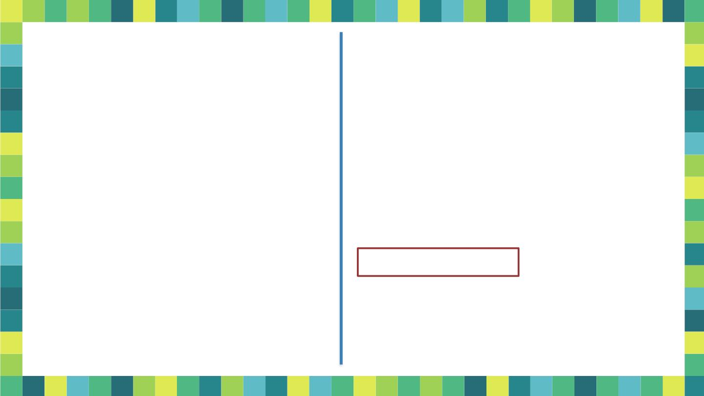
Convert given CFG to GNF
Step 4: Check for Loop
A → A A // i > j
A → A A A // i > j
S → AB
A → BS | b
B → SA | a
3
1
2
3
2
3
2
A → A A A A | b A A
3
3
1
3
2
3
2
Step 1 & 2: Convert to CNF
Already in CNF
Step 5: Eliminate Left
Recursion
A → A A
1
2
3
Step 3: Rename the variables
& Rewrite the prod^{n}s
A → A A | b
2
3
1
A → A A A A | b A A | a
3
3
1
3
2
3
2
S – A₁
A – A₂
B – A₃
A → A A
1
2
3
A → A A | b
2
3
1
A → A A | a
4
3
1
2

Slide 74
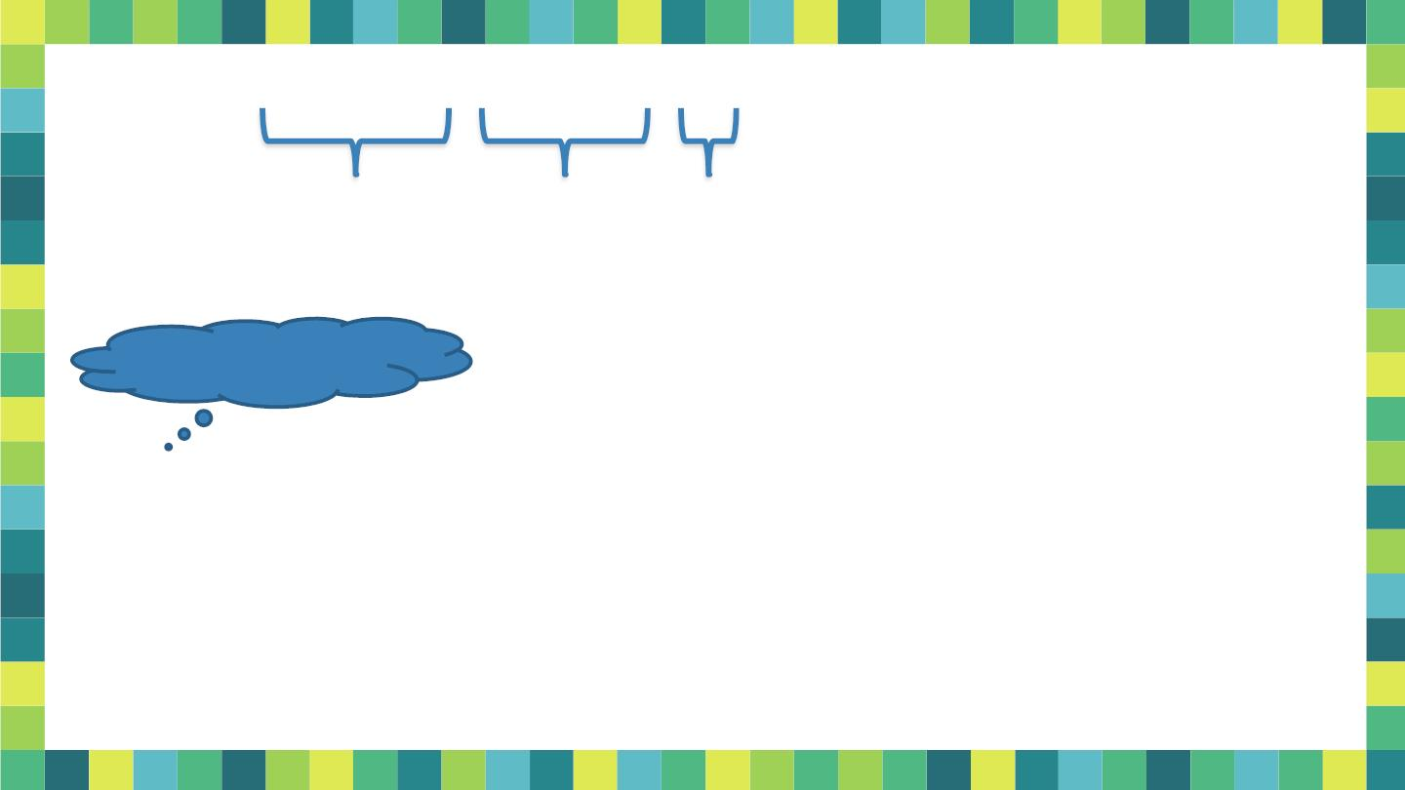
A → A A A A | b A A | a
3
3
1
3
2
3
2
A prod^{n}s are:
A → b A A | a
1
β β
3
3
2
1
2
A → b A A Z | a Z
3
3
2
3
3
’s & β’s ??
Z prod^{n}s are:
Z → A A A Z
3
1
3
2
2
3
Z → A A A
3
1
3

Slide 75

5. Step 6: Do substitution
in prod^{n}s not in GNF
All A prod^{n}s are in GNF
3
A → b A A | b A A Z | a Z | a
A → A A
3
3
2
3
2
3
3
1
2
3
A → A A | b
2
3
1
A → b A A | a
Substitute in A → A A | b
3
3
2
2
3
1
A → b A A Z | a Z
So we get 5 A prod^{n}s
3
3
2
3
3
2
Z → A A A Z
Substitute in A → A A
3
1
3
2
2
3
1
2
3
Z → A A A
So we get 5 A prod^{n}s
3
1
3
1
Substitute in Z → A A A Z | A A A
3
1
3
2
3
1
3
2
Total 24
prod^{n}s
So we get 5 + 5 Z prod^{n}s
3

Slide 76
Convert into GNF
S → XB | AA
A → a | SA
B → b
X → a
Solution:
S → aB | aCA | aBACA | aA | aBAA
A → aC | aBAC | a | aBA
C → aCAC | aBACAC | aAC | aBAAC
C → aCA | aBACA | aA | aBAA
B → b
X → a

Slide 77
Find GNF of the given CFG:
E -> E + T | T, T -> T*F | F, F-> (E)|a

Slide 78
Questions for Practice
1. Convert following grammar into CNF:
2. Convert following grammar to PDA:
3. Eliminate Null and Unit production:

Slide 79
Discussion
Eliminate null production:
S → ASA | aB | b, A → B, B → b | ∈
Solution:
S→ASA | aB | b | a | SA | AS | S, A → B| b, B → b
Remove unit production:
S → XY, X → a, Y → Z | b, Z → M, M → N, N → a
Solution:
S → XY, X → a, Y → a | b, Z → a, M → a, N → a (after removal of unit production)
S → XY, X → a, Y → a | b [after removal of unreachable symbols since, Z, M, and N are unreachable]
Eliminate null production:
S → XYX
X → 0X | ε
Y → 1Y | ε
Solution:
S → XY | YX | XX | X | Y
X → 0X | 0
Y → 1Y | 1

Slide 80

Pumping Lemma
for
Context Free Languages
51

Slide 81
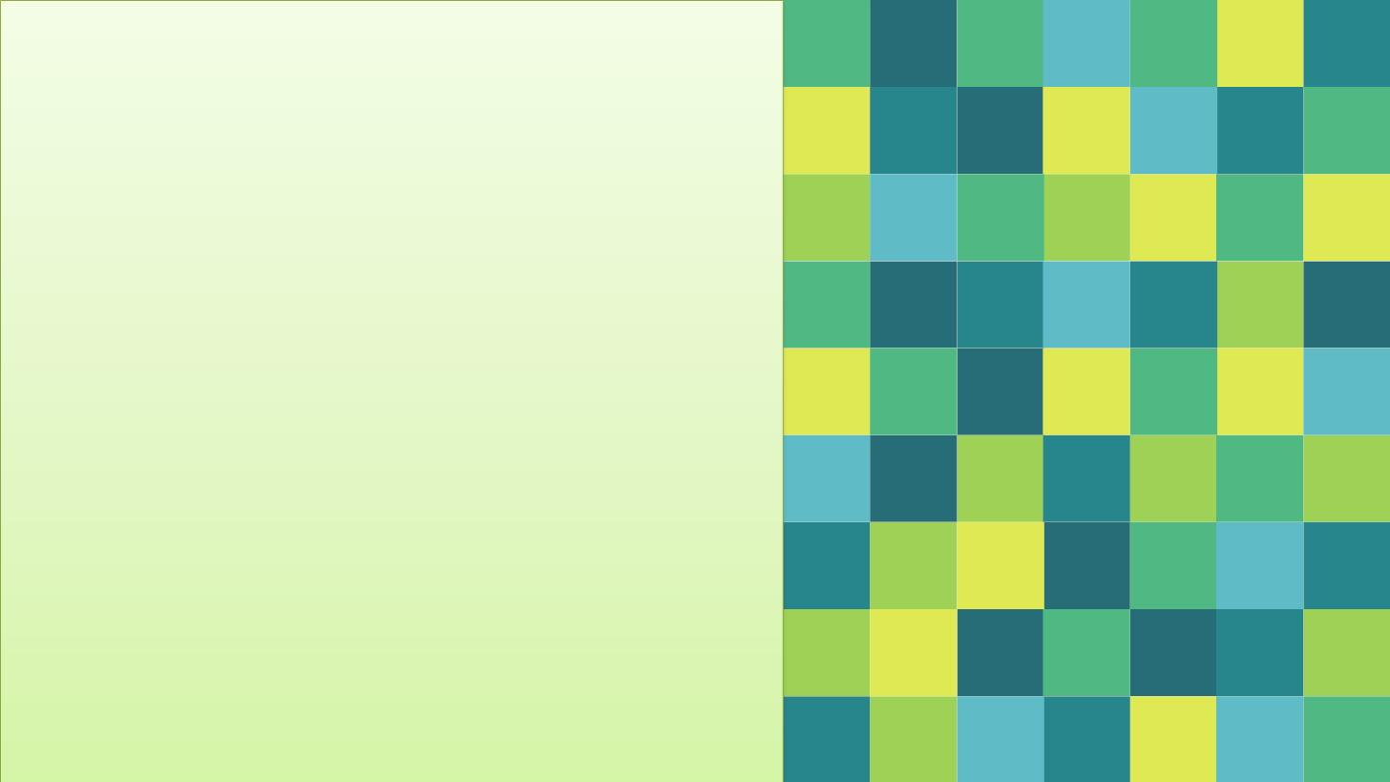
₪ Let L be a CFL. There
exists some integer n such
that for all w in L with
|w| ≥ n,
₪ w = uvxyz with |vxy| ≤ n
and |vy| > 0 such that
₪ uv^{i}xy^{i}z ε L for all i = 0, 1,
2, 3 ....
52

Slide 82

Let G be a grammar in CNF generating the language
L – {ε}
Let the grammar have m variables.
Pick n = 2^{m}.
Let w  L(G) & |w| > n
Any derivation tree for w has height at least m+1.
Consider the following grammar.
S → AB | a
A → AS | b
B → AS | c
Take any string of length 2^{p} & check that the height is atleast p+1.
53
Jan 20, 2020

Slide 83
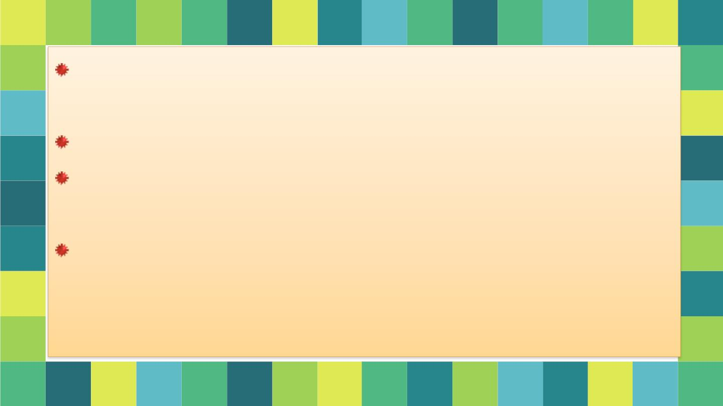
If any derivation tree for w has height at least m+1, then the
number of nodes in the path is at least m + 2.
One node is the leaf node labeled with a terminal.
At least m + 1 node are internal nodes labeled with non-
terminals.
Since there are only m non-terminals in the grammar, and since
m+1 appear on this long path, it follows that some non-terminal
(and perhaps many) appears at least twice on this path.
54
Jan 20, 2020

Slide 84
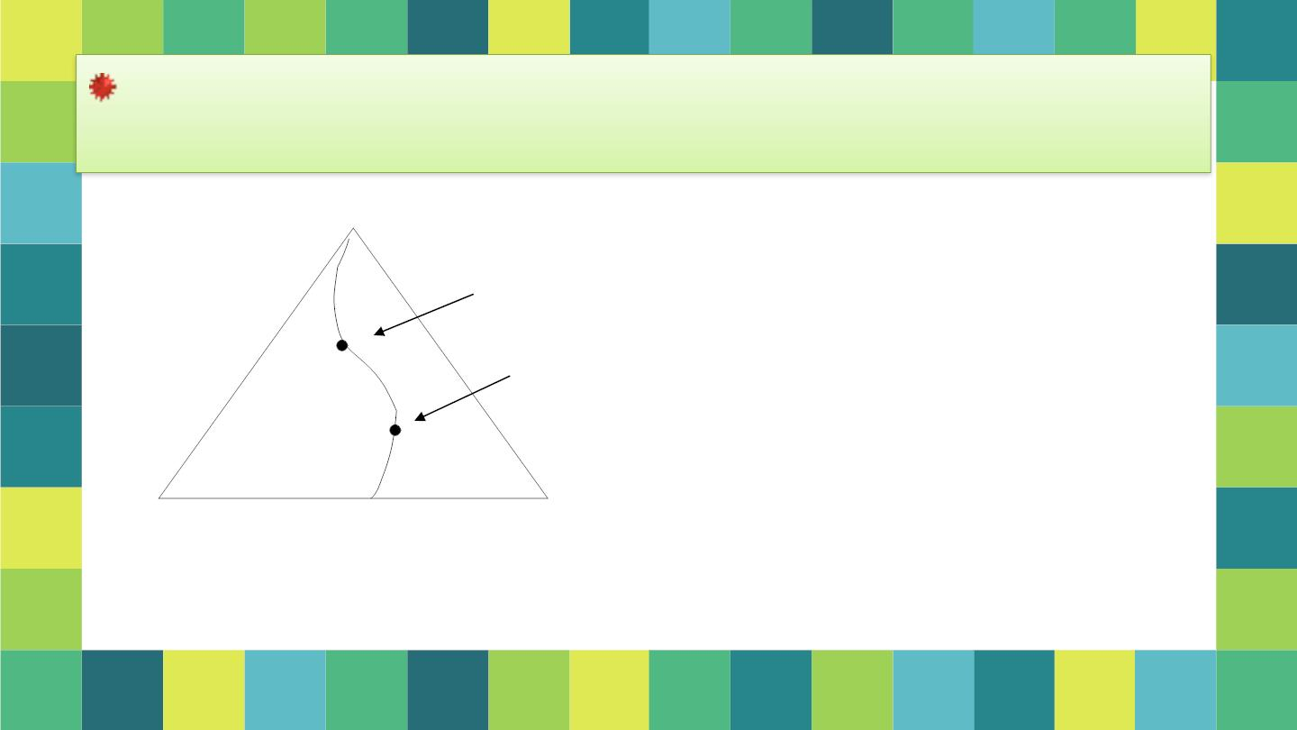
Consider the first non-terminal that is repeated, when
traversing the path from the leaf to the root.
S
Second occurrence of non-terminal A
A
First occurrence of non-terminal A
A
55

Slide 85
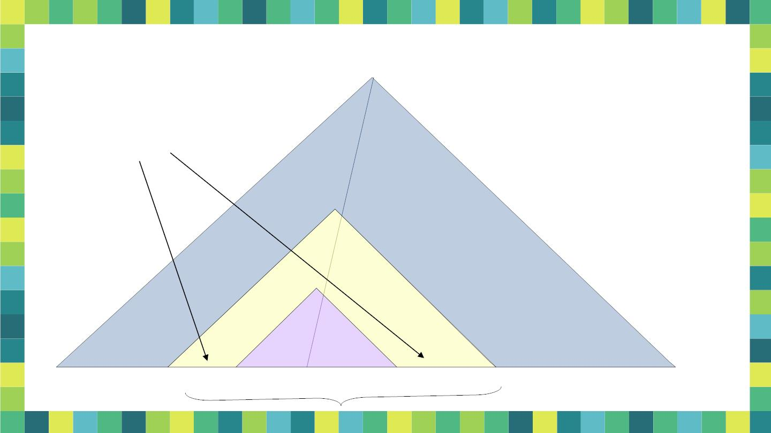
Parse Tree in the Pumping-Lemma Proof
Can’t both be ε as the
grammar is in CNF.
A
A
u
v
x
y
z

Slide 86
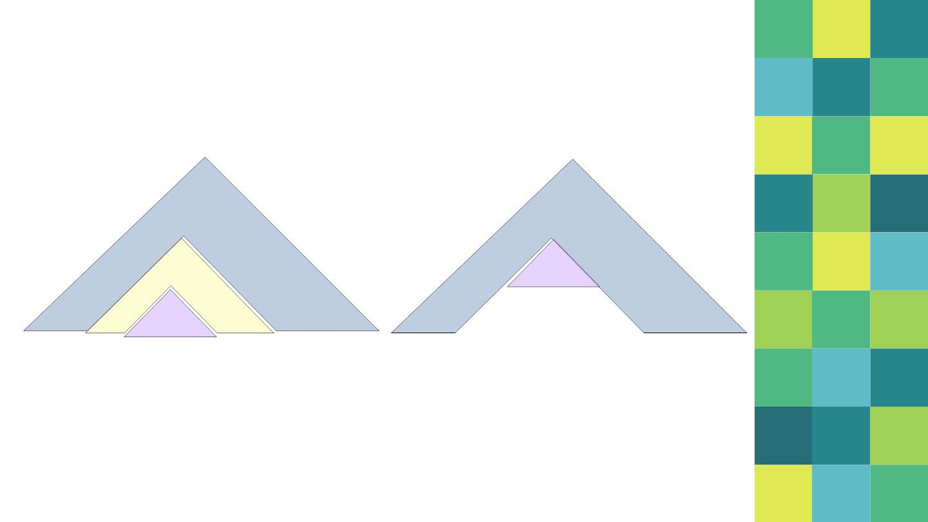
Pump Zero Times
A
A
A
x
u v
x
y
z
u
y
57
Jan 20, 2020

Slide 87
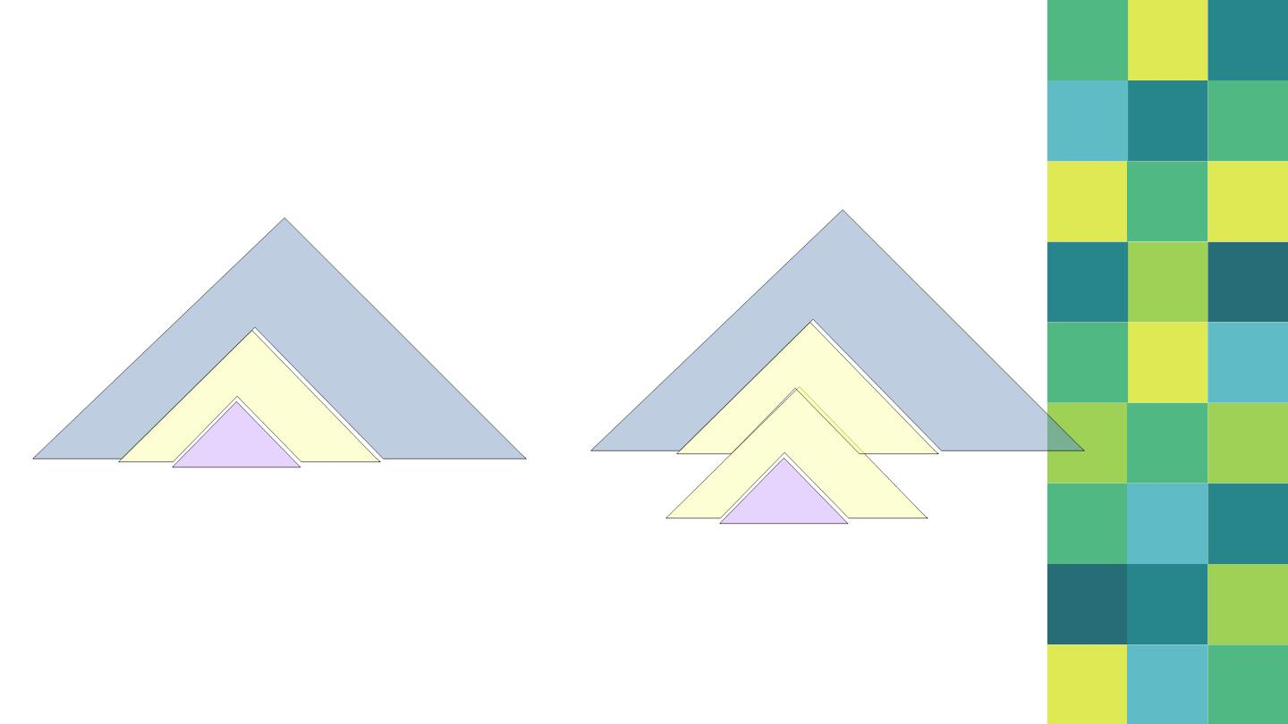
Pump Twice, Thrice …
A
A
A
A
A
u v
y
z
u v
v
y
z
x
x
y
58
Jan 20, 2020

Slide 88

Observe
We have the production rules which lead us to the
following derivations:
➢ w = uvxyz with |vxy| ≤
➢ S ⇨ u A z
n and |vy| > 0 such that
➢ A ⇨ v A y
➢ uv^{i}xy^{i}z ε L
for all i = 0, 1, 2, 3 ....
➢ A ⇨ x
Jan 20, 2020
59

Slide 89

Prove that L = {a^{i} b^{i} c^{i} | i ≥ 0} is not a CFL.
Proof:
. Let L be a CFL. Since L is infinite, the pumping lemma can
be applied. Let n be the constant of the lemma.
. Let w  L & w = a^{k} b^{k} c^{k} for some k > n.
o Then we can write w = uvxyz
o Such that |vy| > 0
o And |vxy| ≤ n
. Since |vxy| ≤ n, therefore it cannot contain all 3 symbols –
a, b & c

Slide 90
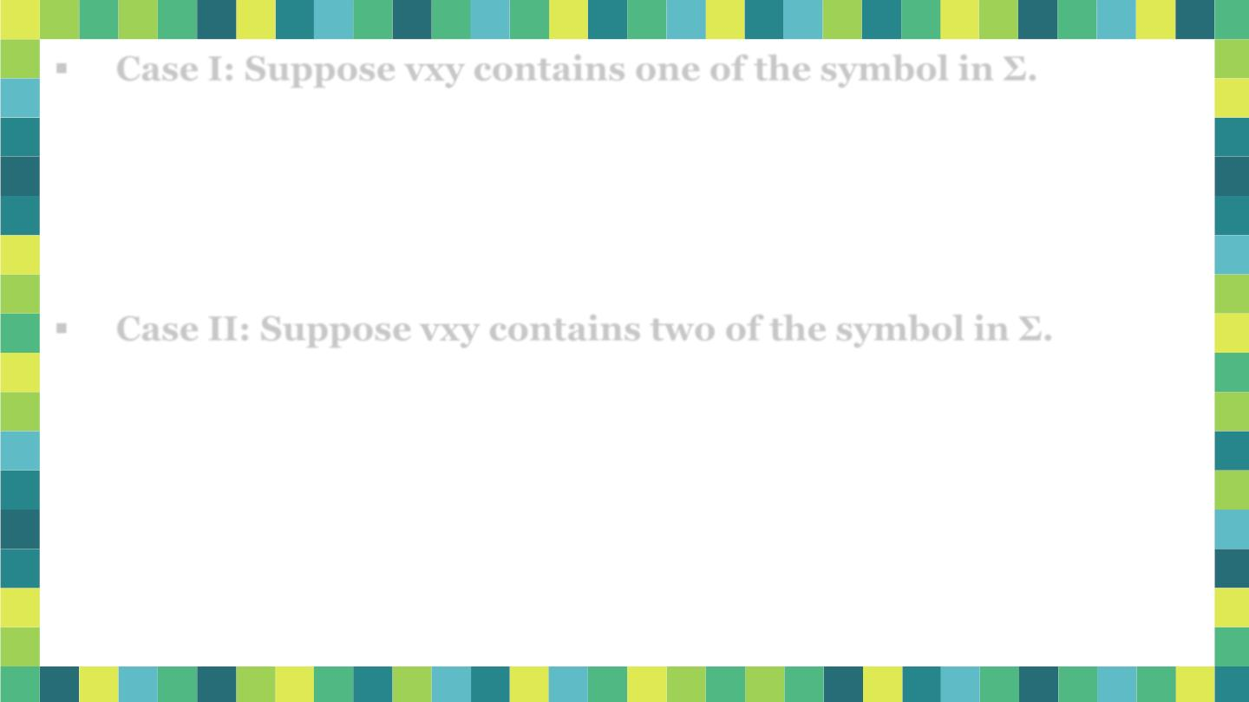
. Case I: Suppose vxy contains one of the symbol in Σ.
o Suppose vxy contains at least one a.
_{o Then uv}²xy²z will more a’s than b or c.
_{o Therefore uv}²xy²z does not belong to L.
o This is a contradiction of the pumping lemma.
. Case II: Suppose vxy contains two of the symbol in Σ.
o Suppose vxy contains at least one a & at least one b.
_{o Then uv}²xy²z will more a’s & b’s than c.
_{o Therefore uv}²xy²z does not belong to L.
o This is a contradiction of the pumping lemma.
In all the cases we get a contradiction.
Therefore our assumption that L is context free is wrong.
Jan 20, 2020

Slide 91
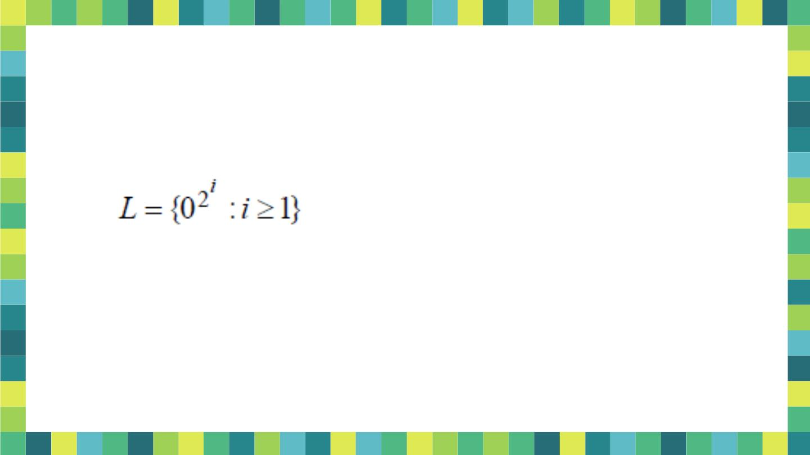
Prove that the following languages are not CFLs.
1) L = {0^{i}1^{i}0^{i}1^{i} | i >0}
2)

Slide 92
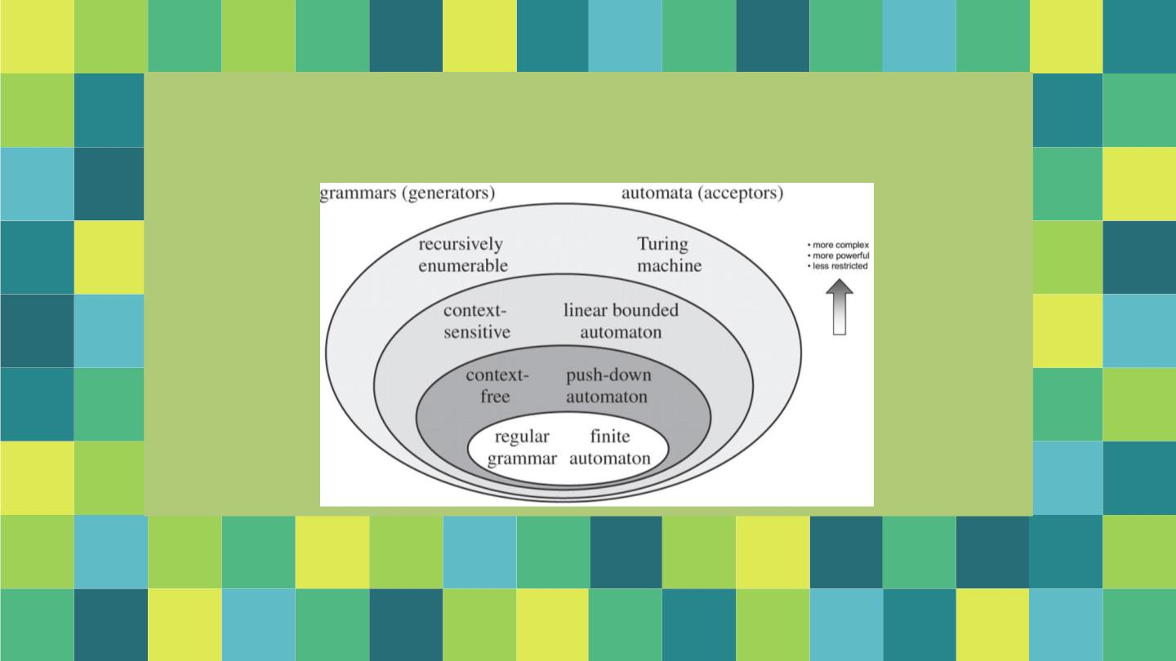
Push Down Automata
63

Slide 93
Equivalence of Push Down Automata &
Context Free Languages
By:
Dr. Sandeep Rathor
69

Slide 94
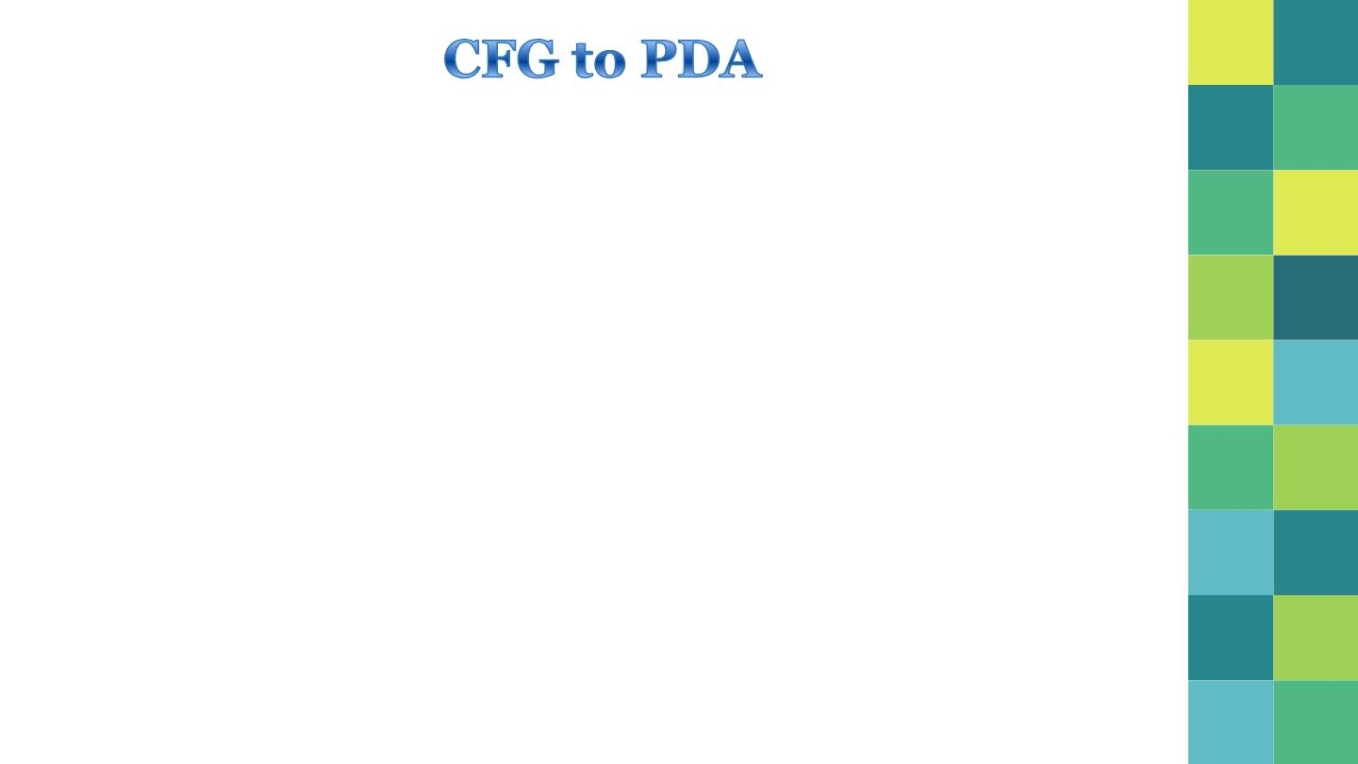
 The PDA simulates the left-sentential forms that G uses to
generate any string w
 Let G = (V, , P, S)
 Construct PDA N that accepts L(G) by empty stack
 N = ({q}, , V  , , q, S)
 Transitions are defined as
❑ For each variable A
(q, ε, A) = {(q, ) | A →  is a prod in G}
n
❑ For each terminal a
(q, a, a) = {(q, ε)}
70

Slide 95
Find a PDA equivalent to the grammar S → aSbb | a
Generate the string aabb and also simulate the PDA for it
 N = ({q}, , V  , , q, S)
(q, aabb, S)
Where  = {a, b}, V = {S} &  is
├ (q, aabb, aSbb)
├ (q, abb, Sbb)
├ (q, abb, abb)
├ (q, bb, bb)
├ (q, b, b)
as following
1. (q, ε, S) = {(q, aSbb), (q, a)}
2. (q, a, a) = {(q, ε)}
3. (q, b, b) = {(q, ε)}
S  aSbb  aabb
├ (q, ε, ε)
Stack Empty – string
accepted

Slide 96
Find a PDA equivalent to the following grammar that
generates simple expressions like a * (a + b010)
E → I | E * E | E + E | (E)
I → a | b | Ia| Ib | I0 | I1
Let N be a PDA that accepts the language generated
by the given CFG
 N = ({q}, , V  , , q, S)
  = {a, b, 0, 1, (, ), *, +}
 V = {E, I)

Slide 97
1. (q, ε, E) = {(q, I), (q, E*E), (q, E+E), (q,(E))}
2. (q, ε, I) = {(q, a), (q, b), (q, Ia), (q, Ib), (q, I0), (q, I1)}
3. (q, a, a) = {(q, ε)}
4. (q, b, b) = {(q, ε)}
5. (q, 0, 0) = {(q, ε)}
6. (q, 1, 1) = {(q, ε)}
7. (q, (, () = {(q, ε)}
8. (q, ), )) = {(q, ε)}
9. (q, *, *) = {(q, ε)}
10. (q, +, +) = {(q, ε)}
73

Slide 98
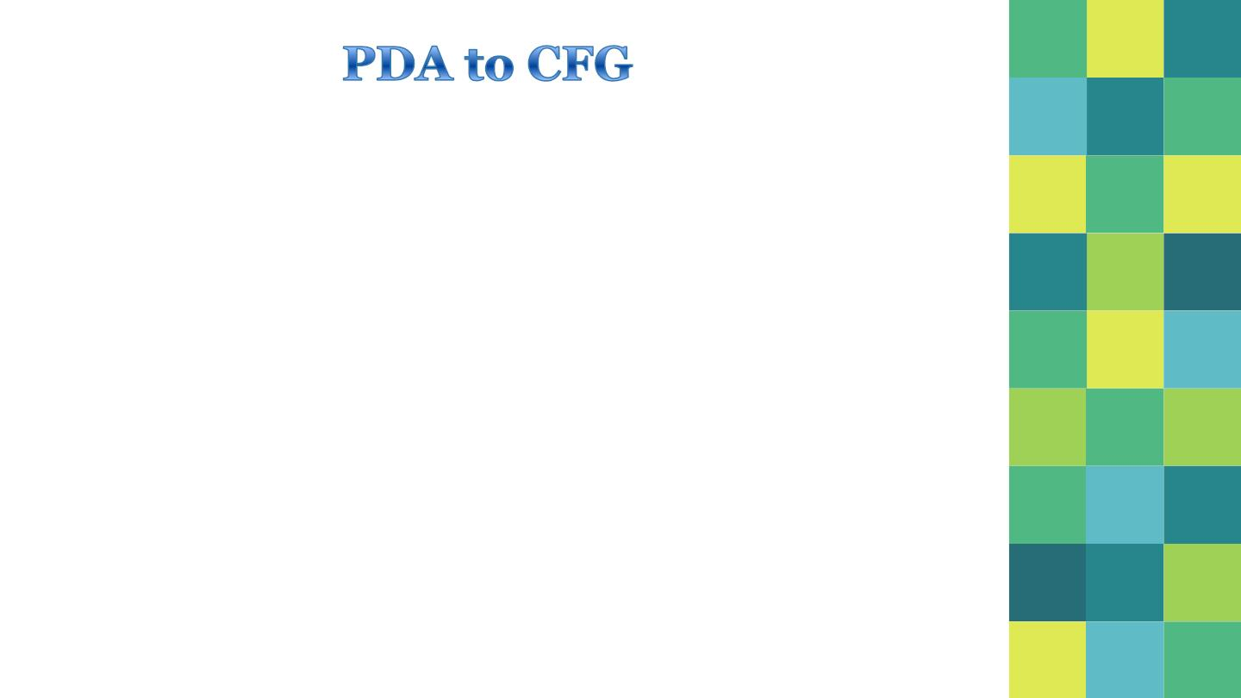
We construct grammar G as follows.
G = (V, , P, S)
✦ V = {S}  {q, z, q] | q, q Q, z  }
The productions in P are induced by the moves of
PDA as follows
✦ Rule 1:
The S productions are given by
S → [q , Z , q]  q  Q
0
0
74

Slide 99
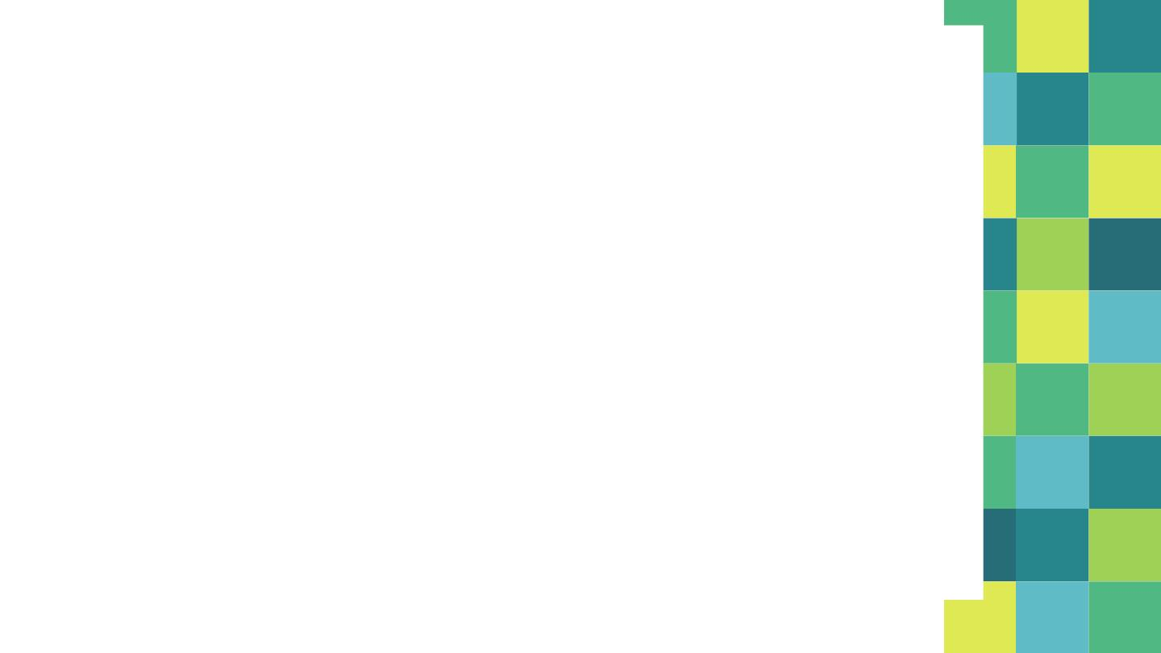
✦ Rule 2:
Each move erasing a pushdown symbol given by
(q , ε)  (q, a, z) induces the prod^{n}
[q, z, q] → a
✦ Rule 3:
Each move not erasing a pushdown symbol given by
(q , z z … z )  (q, a, z) induces many prod^{n}s of the
1 1 2
m
following form where q, q , …, q can be any state in
2
m
Q
[q, z, q] → a [q , z , q ] [q , z , q ] … [q , z , q]
1
1
2
2
2
3
m
m
75

Slide 100
Construct a context-free grammar G which accepts L(N),
where
N = ({qo, q1}, {a. b}, {Zo, Z}, , qo, Zo, φ)
 is given by
1. (qo, b, Zo) = {(qo, ZZo)}
2. (qo, ε, Zo) = {(qo, ε)}
3. (qo, b, Z) = {(qo, ZZ)}
4. (qo, a, Z) = {(q1, Z)}
5. (q1, b, Z) = {(q1, ε)}
6. (q1, a, Z0) = {(qo, Zo)}

Slide 101
Let G = {V, {a, b}, P, S}
✦ V = {S}  {q, z, q] | q, q Q, z  }
V = {S}  {[qo, Zo, qo], [qo, Zo, q1],
[qo, Z , q0], [qo, Z , q1],
[q1, Zo, qo], [q1 , Zo, q1],
[q1, Z , q0], [q1, Z , q1],

Slide 102
The productions in P are induced by the moves of PDA
✦ Rule 1: S → [q , Z , q]  q  Q
0
0
1. S → [q0, Z0, qo]
2. S → [q0, Z0, q1]

Slide 103
✦ Rule 2: (q, a, z) = (q , ε) induces [q, z, q] → a
. (qo, ε, Zo) = {(qo, ε)}
3. [qo, Z0, qo] → ε
. (q1, b, Z) = {(q1, ε)}
4. [q1, Z, q1] → b

Slide 104
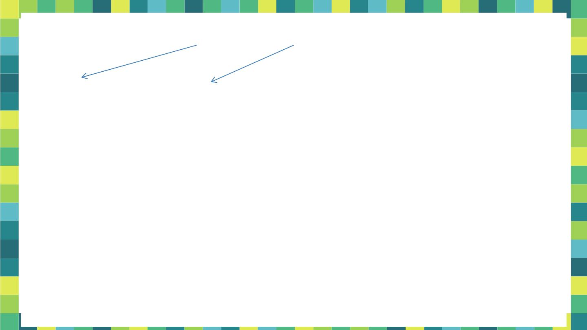
✦ Rule 3: (q, a, z) = (q , z z … z )
1 1 2
m
[q, z, q] → a [q , z , q ] [q , z , q ] … [q , z , q]
1
1
2
2
2
3
m
m
. (qo, b, Zo) = {(qo, ZZo)}
[q0, Zo,  ] → b [q0, Z,  ] [, Z0, ]
5. [q0, Z0, q0 ] → b [q0, Z, q0 ] [q0, Z0, q0]
6. [q0, Z0, q0 ] → b [q0, Z, q1 ] [q1, Z0, q0]
7. [q0, Z0, q1 ] → b [q0, Z, q0 ] [q0, Z0, q1]
8. [q0, Z0, q1 ] → b [q0, Z, q1 ] [q1, Z0, q1]

Slide 105

. (qo, b, Z) = {(qo, ZZ)}
[q0, Z,  ] → b [q0, Z,  ] [, Z, ]
9. [q0, Z, q0 ] → b [q0, Z, q0 ] [q0, Z, q0]
10.[q0, Z, q0 ] → b [q0, Z, q1 ] [q1, Z, q0]
11. [q0, Z, q1 ] → b [q0, Z, q0 ] [q0, Z, q1]
12.[q0, Z, q1 ] → b [q0, Z, q1 ] [q1, Z, q1]

Slide 106
. (qo, a, Z) = {(q1, Z)}
[q0, Z,  ] → a [q1, Z,  ]
13. [q0, Z, q0 ] → a [q1, Z, q0 ]
14.[q0, Z, q1 ] → a [q1, Z, q1 ]
. (q1, a, Z0) = {(qo, Zo)}
[q1, Z0,  ] → a [q0, Z0,  ]
15. [q1, Z0, q0 ] → a [q0, Z0, q0 ]
16.[q1, Z0, q1 ] → a [q0, Z0, q1 ]

Slide 107
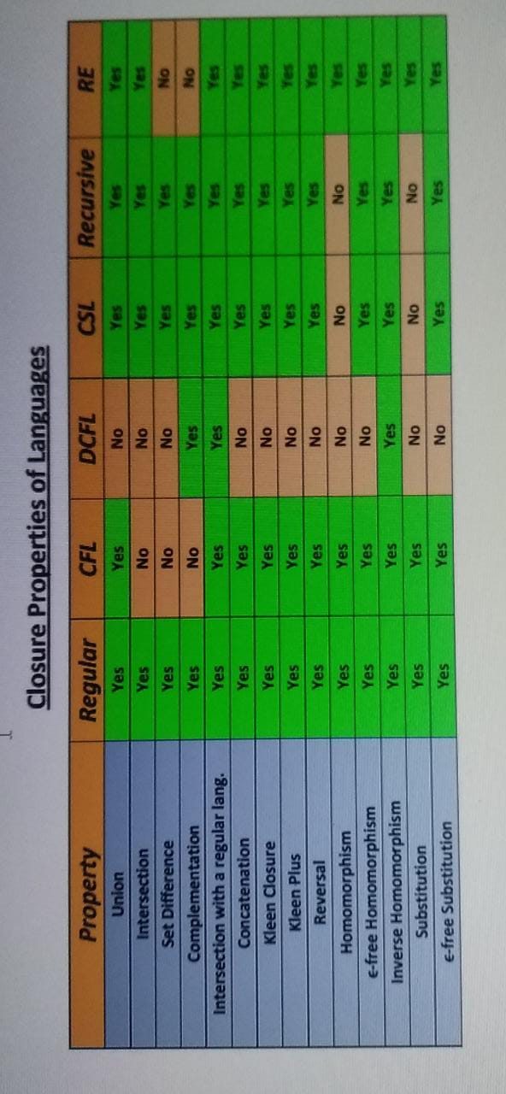

Slide 108
4. Convert following grammar into CNF:
5. Convert following grammar to PDA:
6. Eliminate Null and Unit production:

